Slide 1

Config Check
LLM-assisted configuration anomaly detection for Junos networks
Proof of concept · Proxmox + EVE-NG lab · November 2026
Notes:
Config Check is a proof of concept: it reads device configs through Juniper's MCP server, checks them against our design docs and templates, tracks changes over time and shows rated anomalies on a dashboard. Everything runs on my lab kit with a local LLM.

Slide 2




What the tool does
Reads every device's running config, compares it with how the network is meant to be built, and rates every deviation 1–5 on one dashboard.
Detect
Explain
Track
Prioritise
Exact template rules per role: base, infrastructure and service config. Plus drift between devices in the same role.
A local LLM reads the design docs and reviews each config section and every change, with strict grounding checks.
Every scan is a config snapshot. Diffs, Junos commit history, regressions and pinned baselines.
Severity, compliance score, accepted exceptions and a suggested Junos fix for each finding.
Notes:
Four jobs. Detection is deterministic code. The LLM explains and reviews. History turns scans into backups. The dashboard prioritises.

Slide 3
Architecture
Proxmox host · 192.168.1.14 (Minisforum MS-01)
Windows PC · 192.168.1.232
VM 111 config-check · 192.168.1.39
Ubuntu 26.04 · Docker Compose
HTTP :11434 · embed + JSON-schema chat
Ollama · :11434
RTX 3060 · 12 GB
Browser
dashboard
192.168.1.39:8080
cc-backend · FastAPI :8080
Collector · rule engine · drift · history
LLM orchestration · SQLite · dashboard
VM 108 EVE-NG3 · 192.168.1.38
qwen3.5:9b
review + change review
qfx1 · 192.168.1.52
vJunos-switch 25.4R1
MCP + token
cc-junos-mcp · :30030
Juniper junos-mcp-server
localhost only · token · read-only policy
nomic-embed-text
doc retrieval (RAG)
qfx2 · 192.168.1.53
vJunos-switch 25.4R1
Local models only. Cloud models are blocked by an allow-list.
knowledge/ · data/
design docs · templates · snapshots
Reached over NETCONF :830
Lab EVPN_VXLAN_QFX · role qinq-edge
Notes:
Three machines. The config-check VM runs two containers: the backend and Juniper's MCP server, bound to localhost. The backend only talks to devices through MCP over NETCONF. The LLM runs on my Windows PC's RTX 3060 through Ollama; the VM calls it over the LAN.

Slide 4
Components
Component | Runs on | Address | Job
Dashboard + API | cc-backend container | 192.168.1.39:8080 | UI, scan control, findings, changes, decisions
Scan engine | cc-backend container | n/a | Collect, rules, drift, diff, LLM calls, scoring
Junos MCP server | cc-junos-mcp container | 127.0.0.1:30030 | Device access over NETCONF, block-listed to read-only
Store | SQLite + files on the VM | /opt/config-check/data | Scans, findings, changes, commits, baselines, snapshots
Knowledge | Files on the VM | /opt/config-check/knowledge | HLD, base / infra / service templates
LLM runtime | Ollama on Windows PC | 192.168.1.232:11434 | qwen3.5:9b (review), nomic-embed-text (retrieval)
Lab devices | EVE-NG VM 108 | 192.168.1.52 / .53 | 2 × vJunos-switch 25.4R1, role qinq-edge
Hypervisor | Proxmox VE 9 | 192.168.1.14 | Hosts the config-check and EVE-NG VMs
Notes:
Reference table of every component, where it runs and what it does.

Slide 5
What happens in a scan
1
2
3
4
5
6
7
Collect
Rules
Drift
History
LLM review
Guards
Store + show
Config, facts and commit history for each device, via MCP
Each role's templates checked line by line, scoped per VR and interface
Lines on one device in a role that its peers don't have
Diff against the last snapshot or a pinned baseline, plus risk hints
Changes, then each config section, checked against the retrieved design text
Drop anything ungrounded, duplicated, no-op or self-contradicting
Findings, states (new / recurring / regressed / accepted), score
Code
Code
Code
Code
LLM
Code
Code
About 3 minutes for 2 devices with the model warm: collection about 20 s, rules under 1 s, LLM about 25 s per config section.
Notes:
Six of the seven stages are deterministic code. The LLM sits in one stage and code checks its output before it reaches the dashboard.

Slide 6



What the tool checks against
Design docs
templates/services/sipt-vr.set
knowledge/design/*.md
# @id SVC-BGP-AUTH @sev 4
# @title "eBGP session has no auth"
# @doc "HLD-qinq-edge §4.2"
# @scope ^set routing-instances
# (?P<vr>SIPT\S*) protocols bgp
# group CISCO-ASR\s
set routing-instances {{vr}} protocols
bgp group CISCO-ASR authentication-key {{*}}
# forbidden line: prefix with !
!set system services telnet{{*}}
Prose HLD/LLD. Split by heading, embedded, and retrieved per config section for the LLM.
Templates
knowledge/templates/{base,infra,services}
Junos set lines grouped into rules with ID, severity and design reference. Checked exactly by code.
Inventory
config/inventory.yaml
Roles, the devices in each, which templates apply, per-role variables and drift-ignore patterns.
Notes:
Templates are the exact checks. @scope repeats a rule per SIPT virtual-router. The design doc is what the LLM reads.

Slide 7

How the LLM is used
Retrieve
nomic-embed-text indexes 40 passages: HLD sections plus template rules. The 4 closest are sent with each config section.
Review
qwen3.5:9b gets one config section at a time (system, interfaces, routing), plus what the rules already found.
Change review
Each diff is summarised with an intent and a 1–5 risk. Code risk hints set the floor.
Guards
Every LLM claim must quote real config lines and a design sentence word for word, or it's dropped.
The guards work: nothing wrong reached the dashboard. But at 9B the model finds nothing the rules don't already catch.
Notes:
Honest result: the guards filter everything the 9B model makes up. Its real value now is change summaries. Deeper reasoning needs a bigger model.

Slide 8
Code vs LLM: who does what
Code (deterministic)
LLM (judgement)
Template compliance: exact, repeatable, instant
Scoped checks per VR, interface or VLAN
Drift between devices in the same role
Config diffs, commit window, regressions
Risk hints for known-dangerous changes
Fact-checking every LLM claim
Reads the prose design docs
Plain-English summary and intent for each change
Spots issues that span sections, where templates can't
Best next uses: draft template rules from the HLD and explain findings for the NOC
Limited by a 9B model on a 12 GB GPU
Notes:
The design principle: if it can be checked exactly, code does it. The LLM is for judgement and language, and code checks its output.

Slide 9
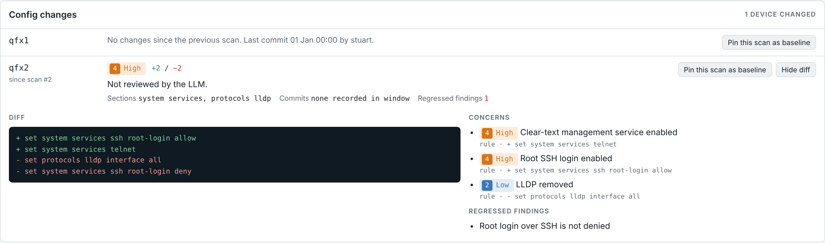
Scans as backups: change tracking
Snapshots
Every scan stores each device's config. The last 50 scans are kept, and pinned baselines are never deleted.
Diff + commits
Compared with the previous scan, with show system commit for who, when and the comment.
Risk
Lab simulation: qfx2 enabled telnet, removed LLDP and reverted a root-login fix
17 code hints (telnet, root SSH, BGP auth/policy removed…) plus the LLM summary.
Finding states
Regressions
A finding that was fixed and comes back is flagged REGRESSED.
NEW first time seen RECURRING also in last scan
REGRESSED gone last scan, back now ACCEPTED exception, kept across scans
Baselines
Pin a known-good scan per device and see drift from it on every scan.
Notes:
No separate backup system needed. Every scan is a snapshot.

Slide 10
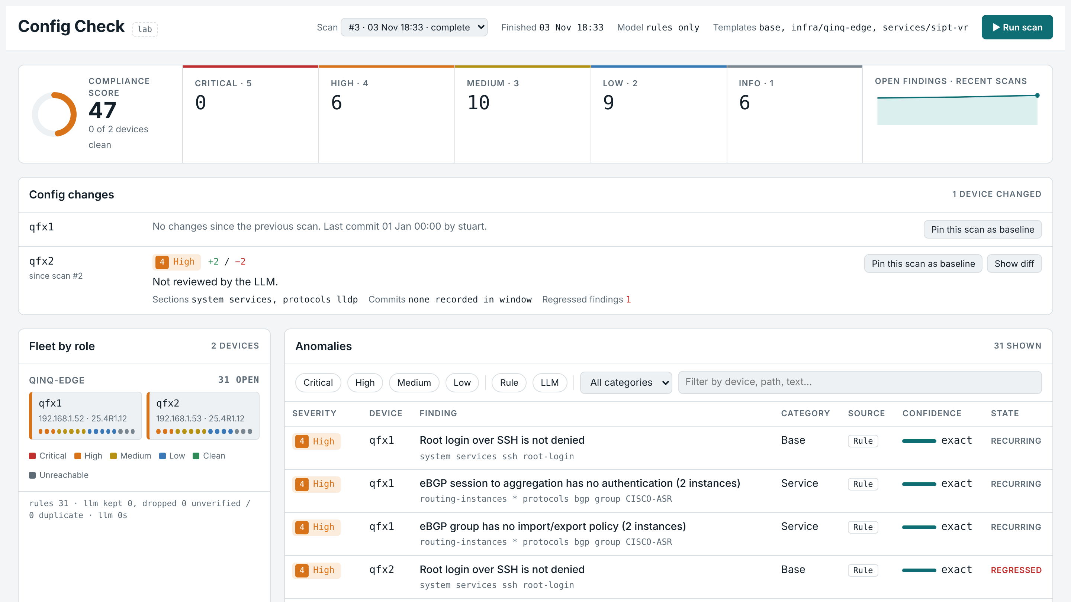
The dashboard
Summary
Score, counts by severity, trend
Config changes
Diff, risk, commits, pin baseline
Fleet by role
Device tiles coloured by worst finding
Anomalies
Filter by severity, source, category
Detail
Evidence, design ref, Junos fix, accept
Lab simulation data
Notes:
Served by the backend on port 8080. Run scan triggers an on-demand scan; progress shows live.

Slide 11



Read-only by design: three layers
1 · Device
2 · MCP server
3 · Backend
Junos login class cc-ro
block.cfg + block.cmd
Tool allow-list
permissions view + view-configuration; request / clear / restart / file / configure denied. SSH key only.
Every config load blocked; only show commands allowed. Bound to localhost with bearer-token auth.
Calls only get_junos_config, gather_device_facts and show commands. Write tools are never called.
Data never leaves the lab: local Ollama only (cloud models refused by an allow-list). Secrets are masked by Junos in configs, and keys and tokens are stored with mode 600.
Notes:
Tested: request system reboot and a config load through MCP were both rejected before reaching the device.

Slide 12
PoC results on the lab
2
23
28
~3 min
vJunos leaves scanned
template rules
real findings, 6 High
per scan, model warm
What it found on the real leaves
eBGP to the Cisco ASR has no authentication and no import/export policy (both VRs, both leaves)
Root SSH login allowed; no NTP, so devices run on local clock; no remote syslog
VLAN QINQ-117-111 carries outer tag 107: the name doesn't match the service
No BFD or prefix limits; leftover MC-LAG config; IPv6 RA on fxp0; syslog drift between the leaves
Notes:
These are real findings against the starter design doc and templates, which will be replaced with the real standards.

Slide 13

Next steps
Real standards
LLM where it adds value
Replace the starter HLD and templates with production design docs.
Draft template rules from the HLD for review; explain findings for the NOC.
Bigger model trial
More roles and devices
Try gpt-oss:20b for cross-section and cross-device reasoning.
PE, P and RR roles; MX and PTX; scheduled scans with alerts.
Notes:
Close: the platform works end to end. Value now comes from real standards and choosing where the LLM earns its place.

